Slide 1
RSM222
Management Accounting 1
Class 3: CVP Analysis & Introduction to Costing Systems
Elisa Zuliani

Slide 2
Learning Objectives of Class 3
Contribution Margin and Contribution Margin Ratio
Variable Expense Ratio
Compute the break-even point
Target Operating Price Analysis / Sensitivity and Indifference Analysis
Margin of safety
Product Costing – Job costing

Slide 3
CVP Analysis
Cost –Volume-Profit

Slide 4
Cost-Volume-Profit Analysis
Cost Behavior Analysis is the study of how specific costs respond to changes in the
level of business activity.
Set of tools to help managers understand the behaviour of total revenues, total costs and operating income when quantity, selling price, variable or fixed costs of the product change.
Focuses on the interactions among:
  Prices of products
  Volume or level of activity
  Per unit variable costs
  Total fixed costs
  Mix of products sold
Types of Activity Levels
Sales dollars (retail company)
Miles driven (trucking company).
Room occupancy (hotel).
Dance classes taught (dance studio).

Slide 5
CVP Income Statement
A statement for internal use.
Use to Make Decisions!
CVP income statement classifies costs as fixed or variable and computes a contribution margin.
Contribution margin is the amount of revenue remaining after deducting variable costs.
Reports same net income as a traditional income statement.
Revenue (Price*Quantity)
Less: Variable Costs (VC/unit * Quantity)
Contribution Margin
Less: Fixed Costs
Net Income (CM – FC)

Slide 6
Key Formulas
Unit Contribution Margin
  Contribution margin is available to cover fixed costs and to contribute to income.
Unit Contribution Margin = Price – VC per Unit
Contribution Margin Ratio
  Shows the percentage of each sales dollar available to apply toward fixed
costs and profits.
Contribution Margin Ratio = Unit Contribution Margin / Price
OR: Contribution Margin Ratio = Total CM/Total Revenue
Don’t Trust Me? Do the algebra…

Slide 7
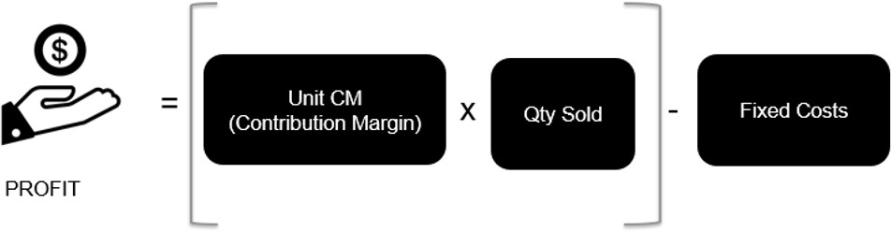
Profit Equation
Price – Variable Costs

Slide 8
Levers of Profitability
Easier said than done…
Increase Selling Price
Increase Qty Sold
Decrease Variable Costs
Decrease Fixed Costs

Slide 9
Let’s apply…
Coffee Klatch is an espresso stand in a downtown office building. The average selling price of a cup of coffee is $4.00 and the average variable expense per cup is $1.00. The average fixed expense per month is $3,000. 2,100 cups of coffee are sold each month on average. What is the CM Ratio for Coffee Klatch?
  a. 33%
  b. 75%
  c. 25%
  d. 400%

Slide 10
Let’s apply…
Coffee Klatch is an espresso stand in a downtown office building. The average selling price of a cup of coffee is $4.00 and the average variable expense per cup is $1.00. The average fixed expense per month is $3,000. 2,100 cups of coffee are sold each month on average. What is the CM Ratio for Coffee Klatch?
Answer:
  75%
  CM Ratio = Unit Contribution Margin = $4.00 - $1.00
  Unit Selling Price $4.00

Slide 11
Variable Expense Ratio
The variable expense ratio is the ratio of variable expenses to sales:
Variable expense ratio = Variable Expenses / Sales
This leads to a useful equation that relates the CM ratio to the variable expense ratio as follows: = Variable expenses / Sales
CM ratio = CM / Sales
CM ratio = (Sales – Variable expenses) / Sales expenses / Sales
CM ratio = 1 – Variable expense ratio

Slide 12
Change in Fixed Cost and Sales
What is the impact on profit if sales increase from 500 units to 540 units due to a $10,000 increase in the monthly advertising budget?
Contribution Margin/ unit
= $100,000/ 500 units
= $200/ unit
Example Company Contribution Income Statement For the Month of June
 | Current Sales (500 units) | Projected Sales (540 units)
Sales revenue | $250,000
Less: Variable expenses | 150,000
Contribution Margin | $100,000
Less: Fixed expenses | 80,000
Operating Income | $ 20,000
Sales $ / unit = $250,000 /500 units
= $500 / unit
Contribution Margin ratio
= $100,000/$250,000
= 40%

Slide 13
Change in Fixed Cost and Sales
What is the impact on profit if sales increase from 500 units to 540 units due to a $10,000 increase in the monthly advertising budget?
$80,000 + $10,000 advertising = $90,000
Example Company Contribution Income Statement For the Month of June
 | Current Sales (500 units) | Projected Sales (540 units)
Sales revenue | $250,000 | $270,000
Less: Variable expenses | 150,000 | 162,000
Contribution Margin | $100,000 | $108,000
Less: Fixed expenses | 80,000 | 90,000
Operating Income | $ 20,000 | $ 18,000
Sales
= $500 x 540 units
= $270,000
Sales increased by $20,000, but operating income decreased by $2,000.

Slide 14
Change in Fixed Cost and Sales
The CM Solution:
Increase in CM (40 units x $200) $ 8,000
Increase in advertising expenses (10,000)
Decrease in net operating income (2,000)

Slide 15
Change in Variable Cost and Sales
What is the impact on profit if a higher quality of raw materials is used, thus increasing variable costs per unit by $10. Assume that the increase in quality generates an increase in unit sales from 500 to 580?
Contribution Margin/ unit
= $100,000/ 500 units
= $200/ unit
Example Company Contribution Income Statement For the Month of June
 | Current Sales (500 units) | Projected Sales (580 units)
Sales revenue | $250,000
Less: Variable expenses | 150,000
Contribution Margin | $100,000
Less: Fixed expenses | 80,000
Operating Income | $ 20,000
Sales $ / unit = $250,000 /500 units
= $500 / unit
Variable Costs $ / unit = $150,000 /500 units
= $300 / unit
Contribution Margin ratio
= $100,000/$250,000
= 40%

Slide 16
Change in Variable Cost and Sales
What is the impact on profit if a higher quality of raw materials is used, thus increasing variable costs per unit by $10. Assume that the increase in quality generates an increase in unit sales from 500 to 580?
Example Company Contribution Income Statement For the Month of June
 | Current Sales (500 units) | Projected Sales (580 units)
Sales revenue | $250,000 | $290,000
Less: Variable expenses | 150,000 | 179,800
Contribution Margin | $100,000 | $110,200
Less: Fixed expenses | 80,000 | 80,000
Operating Income | $ 20,000 | $ 30,200
Variable Costs = 580 units x $310 vc/unit
= $179,800
Sales increased by $40,000, but operating income increased by $10,200.

Slide 17
Change in Variable Cost and Sales
The CM Solution:
Increase in VC of $10 x 500 units $ (5,000)
Increase in units sold:
80 units x 190 (200 – 10) 15,200
Increase in net operating income $ 10,200

Slide 18
Let’s apply
What is the impact on profit if:
  selling price is cut by $20 per unit,
  the advertising budget is increased by $15,000 per month, and
  sales increase from 500 to 650 units per month?

Slide 19
Let’s apply …
Example Company Contribution Income Statement For the Month of June
 | Current Sales (500 units) | Projected Sales (650 units)
Sales revenue | $250,000
Less: Variable expenses | 150,000
Contribution Margin | $100,000
Less: Fixed expenses | 80,000
Operating Income | $ 20,000
Contribution Margin/ unit
= $100,000/ 500 units
= $200/ unit
Sales $ / unit = $250,000 /500 units
= $500 / unit
Contribution Margin ratio
= $100,000/$250,000
= 40%

Slide 20
Let’s apply
Example Company Contribution Income Statement For the Month of June
 | Current Sales (500 units) | Projected Sales (650 units)
Sales revenue | $250,000 | $ xx
Less: Variable expenses | 150,000 | x
Contribution Margin | $100,000 | x
Less: Fixed expenses | 80,000 | x
Operating Income | $ 20,000 | $ x

Slide 21
Change in Variable Cost and Sales
The CM Solution:
Increase in selling price $20 x 500 units $ 10,000
Increase in CM for additional units
$180 x 150 units $ 27,000
Increase in advertising (fixed costs) (15,000)
Increase in net operating income $ 22,000

Slide 22






Assumptions of Cost-Volume-Profit Analysis
Selling price is constant throughout the entire relevant range
Price of product/service doesn’t change as volume changes
Costs can be divided between variable and fixed elements → Variable costs are constant per unit and fixed costs are constant overall.
In multi product company → Sales mix is constant.
Inventories do not change – a unit produced is a unit sold.

Slide 23
Break even analysis

Slide 24
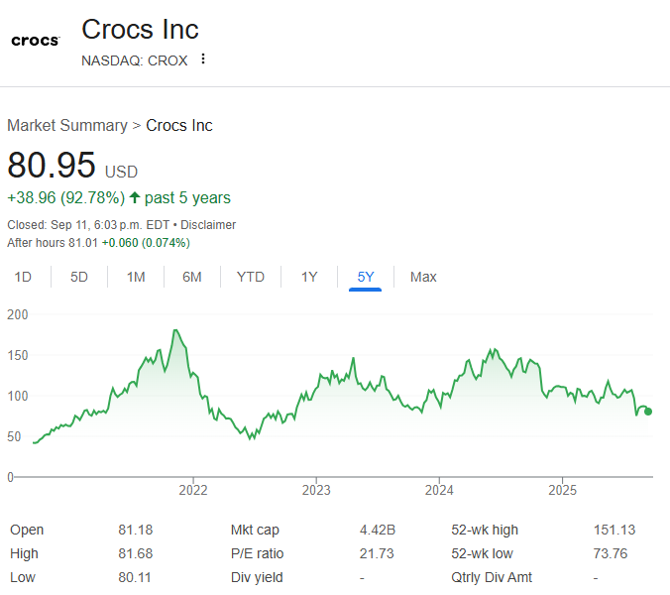

IN CLASS EXAMPLE
Although the price has recently fallen, you still can’t believe the stock price and market cap of shoes you thought were only popular on Grey’s Anatomy.
You have decided to compete with Crocs and are starting Alligator’s.

Slide 25


Cost of Sandals
Plastic: $2 | Bldg Amort: $35,000/yr | Administration: $200,000/yr
Labour: $1 | Utilities: $40,000/yr | Management: $350,000/yr
Paint: $0.50 | Advertising: $35,000/yr
Packaging: $0.50 | New Sandal Design: $100,000/yr | Selling price per unit is $10 and they currently sell 250,000 units.
For those of you who thought the concept was ridiculous …

Slide 26
Calculate the CM and CM Ratio
CM per unit
(Price – Unit VC)
Price - (Plastic + Labour + Paint + Packaging)
$10 – $2 – $1 - $.5 - $.5
Sales
$ 2,500,000
Variable Costs
 | Plastic | $ 500,000
 | Labour | $ 250,000
 | Paint | $ 125,000
 | Packaging | $ 125,000
$6/unit
CM ratio
Contribution Margin
$ 1,500,000
Fixed Costs
 | Bldg Amort | $ 35,000
 | Utilities | $ 40,000
 | Advertising | $ 35,000
 | Sandal Design | $ 100,000
 | Administration | $ 200,000
 | Management | $ 350,000
Unit CM / Price
$6/$10
60%
What do these mean?
Operating Income
$ 740,000

Slide 27
Revenues – Variable Costs – Fixed Costs = 0
Break-Even Point
Break-Even Point is level of activity at which total revenues equal total costs (both fixed and variable).
  Expressed either in sales units or in sales dollars
  At the break-even point, contribution margin must equal total fixed costs.
    Break-even point can be computed using either contribution margin per
unit or contribution margin ratio
Fixed Costs | ÷ | Unit Contribution Margin | = | Break-Even Point in Units
Fixed Costs | ÷ | Contribution Margin Ratio | = | Break-Even Point in Dollars

Slide 28
Break-Even Point
How many sandals would Alligator need to sell to break-even?
Inputs:
1. Fixed Costs
= Bldg Amort + Administration + Utilities + Management + Advertising + New Sandal Design
= $35,000 + $200,000 + $40,000 + $350,000 + $35,000 + $100,000
= $760,000
Unit CM = Price – VC per Unit = $10 - $4 = $6/unit
CM ratio = Unit CM / Price = $6/$10 = 60%
Why is this useful?
760,000 FC | ÷ | $6/unit Unit CM | = | 126,666.67 | Break-Even Point in Units
760,000 FC | ÷ | 60% CM Ratio | = | $1,266,666,67 | Break-Even Point in Dollars

Slide 29
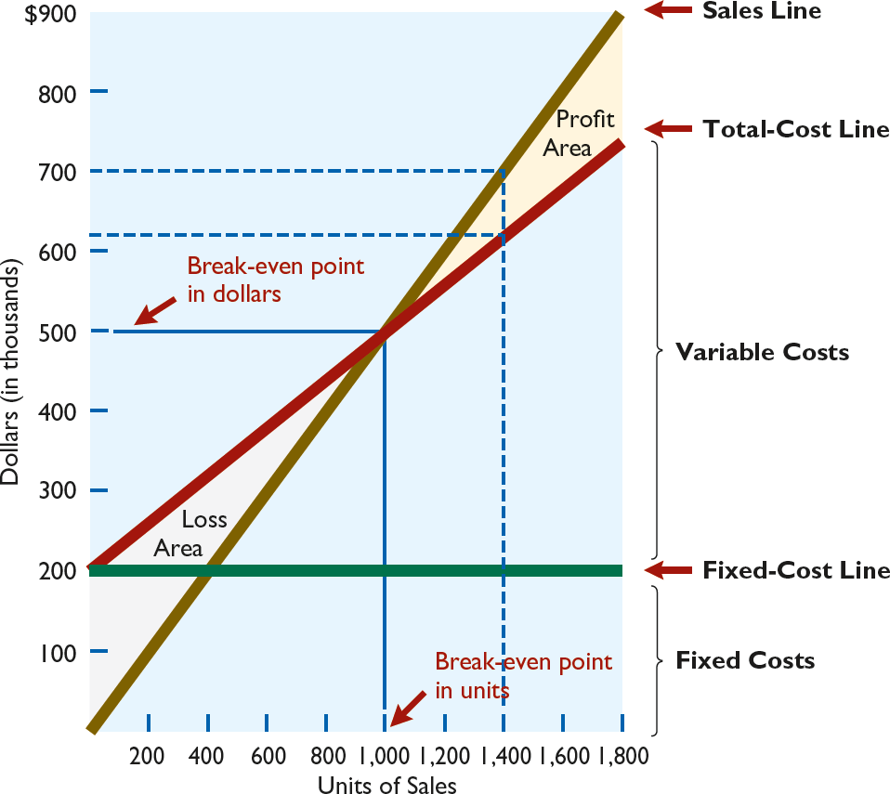
Break-Even Point (Graph or “Substitution” Method)
Revenues – Variable Costs – Fixed Costs = 0
Revenues Price * Quantity
10Q
6Q Q
Revenues
= Variable Costs + Fixed Costs
= VC/unit * Quantity + Fixed Costs
= 4Q + $760,000
= 760,000
= 126,667 units
= Price * Quantity
= $10/unit * 126,667 units
Do what is easiest and convert!
= $1,266,667

Slide 30

Target Operating Profit Analysis
I would like to see our profits go up to
$1,000,000. Assuming that fixed costs won’t change, how many units would you need to sell?
Is this not just a Break-Even Analysis?
Units to attain target profit
Fixed Expenses + Target Profit
Unit CM
=
Target profits
1-tax rate
* If given an after tax profit, use

Slide 31
Margin of Safety
Difference between actual or expected sales and sales at break-even point.
  Measures “cushion” that a particular level of sales provides.
  May be expressed in dollars or as a ratio.
Actual (Expected) Sales | − | Break-Even Sales | = | Margin of Safety in Dollars
Margin of Safety In Dollars | ÷ | Actual (Expected) Sales | = | Margin of Safety Ratio

Slide 32
Make the Decision
If Alligator increases advertising expense to $50,000, they expect that sales will go up from 250,000 units to 265,000 units.
Status-Quo |  |  | Proposal
Sales |  | $ 2,500,000 | $ 2,650,000
Variable Costs: | Plastic | $ 500,000 | $ 530,000
 | Labour | $ 250,000 | $ 265,000
 | Paint | $ 125,000 | $ 132,500
 | Packaging | $ 125,000 | $ 132,500
Contribution Margin |  | $ 1,500,000 | $ 1,590,000
Fixed Costs: | Building | $ 35,000 | $ 35,000
 | Utilities | $ 40,000 | $ 40,000
 | Advertising | $ 35,000 | $ 50,000
 | Design | $ 100,000 | $ 100,000
 | Admin | $ 200,000 | $ 200,000
 | Management | $ 350,000 | $ 350,000
Operating Income Increases. Therefore, Accept.
Other Considerations?
Operating Income
$ 740,000 $ 815,000

Slide 33
Make the Decision
If Alligator decreases the selling price to
$9, they expect to sell 25,000 more units.
Status-Quo |  |  | Proposal
Sales |  | $ 2,500,000 | $ 2,475,000
Variable Costs: | Plastic | $ 500,000 | $ 550,000
 | Labour | $ 250,000 | $ 275,000
 | Paint | $ 125,000 | $ 137,500
 | Packaging | $ 125,000 | $ 137,500
Contribution Margin |  | $ 1,500,000 | $ 1,375,000
Fixed Costs: | Building | $ 35,000 | $ 35,000
 | Utilities | $ 40,000 | $ 40,000
 | Advertising | $ 35,000 | $ 35,000
 | Design | $ 100,000 | $ 100,000
 | Admin | $ 200,000 | $ 200,000
 | Management | $ 350,000 | $ 350,000
Operating Income Decreases. Therefore, Don’t Accept.
Other Considerations?
Operating Income
$ 740,000 $ 615,000

Slide 34
Sensitivity Analysis
We have estimated the impact of variables on quantity to be sold and profits to be made.
How certain are we of the increase in quantity as a response to change X?
Sensitivity Analysis is a « what if » technique that examines how results would change if data predicted is not achieved.
How do we do this?
What about Break-Even? Try with Adv. Example
15,000 FC | ÷ | $6/unit Unit CM | = | 2,500 | Break-Even Point in Units
15,000 FC | ÷ | 60% CM Ratio | = | $25,000 | Break-Even Point in Dollars

Slide 35
Indifference Analysis
At what level of unit sales would you be indifferent between alternatives?
Alligator currently has a production process that is more labour intensive than their competitors. As the plant is expanding, they have an option of switching to a more automated process. Labour would decrease to $.5/unit. However, an automated machine would cost an additional $100,000/year
 | Status Quo | Automation
CM/unit | $6/unit | $6.50/unit
Fixed Costs | 760,000 | 860,000
If Q> 200,000: Automate
If Q< 200,000: Status Quo If Q = 200,000 → Either
$6Q - 760,000 = $6.50Q – 860,000 100,000 = .5Q
Q = 200,000
32

Slide 36
Product Costing

Slide 37
Costing Methods Overview
Costing Methods
Costing methods are used to assign a cost to a manufactured product.
Absorption Costing
Job-Order
Absorption Costing
Process
Activity Based Costing (ABC
Variable Costing
Gross
Margin
Gross
Margin
Classify costs based on judgment and decision at hand
There are no specific rules to classification
Uses multiple cost pools
Find the best driver (allocation base) for each cost pool
Contribution
Margin
Classify costs between product and period costs
OH rate used to allocate indirect costs
Accepted under ASPE and IFRS
Unit costs are computed by department
Products in a process costing environment in sequence from one department to another
Classify costs between variable and fixed costs
Class 3
Class 4
Class 5
Class 6

Slide 38
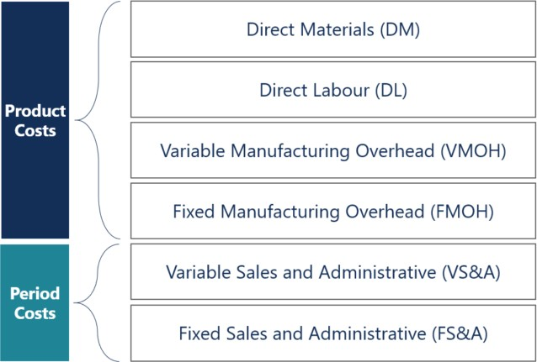
Types of Product Costing Systems
ABSORPTION COSTING:
includes ALL manufacturing
costs
Job-Order
Costing
(Chapter 5)
Process
Costing
(Chapter 6)
Many different products are produced each period
Products are manufactured to order.
The unique nature of each order requires tracing or allocating costs to each job and maintaining cost records for each job.
5-38

Slide 39
Types of Product Costing Systems
Job-Order
Costing
(Chapter 5)
Process
Costing
(Chapter 6)
Example companies:
Bombardier (aircraft manufacturing)
Bechtel International (large scale construction)
Hallmark (greeting card design and printing)
5-39

Slide 40
Types of Product Costing Systems
Job-Order
Costing
(Chapter 5)
Process
Costing
(Chapter 6)
A company produces many units of a single product
One unit of product is indistinguishable from other units of product
The identical nature of each unit of product enables assigning the same average cost per unit
5-40

Slide 41
Types of Product Costing Systems
Job-Order
Costing
(Chapter 5)
Process
Costing
(Chapter 6)
Example companies:
St. Mary’s Cement (cement mixing)
Petro-Canada (refining oil)
Coca-Cola (mixing and bottling beverages)
5-41

Slide 42
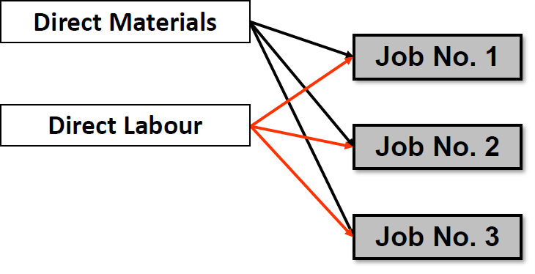
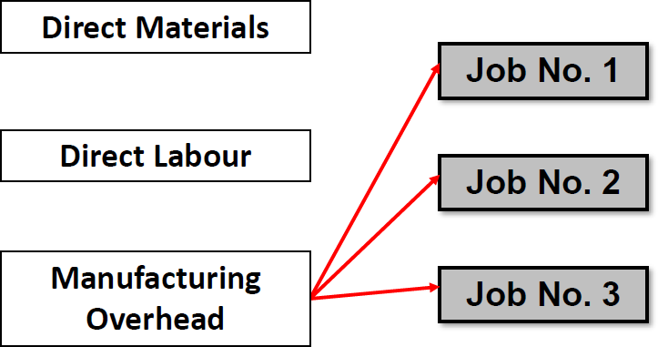
Overview of Job-Order Costing
Direct material and direct labour costs are traced directly to each job as work is performed.
Manufacturing Overhead (including indirect material and indirect labour) are allocated to all jobs rather than traced directly to each job.

Slide 43
Allocating Manufacturing Overhead (MOH)
What word stands out?
Cost allocation is the process of assigning indirect costs to products by:
Step 1: Compute the Overhead Allocation Rate
Overhead Rate
Estimated Manufacturing OH Costs ($)
=
Estimated Total Units of Allocation Basis
Step 2: Allocate to the cost object:
Overhead Rate
Cost Object’s
consumption of the allocation basis
x

Slide 44
Why use POHR?
A company could wait until the end of the accounting period to compute an actual overhead rate based on actual total manufacturing costs and actual total units in the allocation base.
Benefits of Predetermined Rates
Using a predetermined rate makes it possible to estimate total job costs sooner.
Actual overhead for the period is not known until the end of the period.
Actual overhead costs can fluctuate seasonally, leading to misleading
decisions.

Slide 45
Allocating Manufacturing Overhead (MOH) (cont’d)
Overhead applied = POHR × Actual activity
Based on estimates, and determined before the period begins.
Actual amount of the cost driver incurred during the period

Slide 46
Journal Entires
1) Actual OH (Ex. Indirect Labor)
DR MOH xxxx
 | CR Wages Payable xxxx
MOH (T-Account)
Actual OH | Applied OH
1) Applied OH
DR WIP xxxx
 | CR MOH xxxx
Ending Balance = 0
What if Actual OH ≠ Applied OH?

Slide 47
Under / Over Applied Overhead
UNDER
APPLIED
Actual OH costs ≥ OH Costs applied to WIP.
OVER
APPLIED
Actual OH costs ≤ OH Costs applied to WIP.
Why is MOH a temporary account (Remember 219…)?

Slide 48
Accounting for Under/Over Applie Overhead
UNDER APPLIED OVERHEAD COSTS | Close the difference to COGS COGS……………………….XXX Manufacturing OH…………..XXX
OVER APPLIED OVERHEAD COSTS | Allocate difference between WIP, Finished Goods and COGS in proportion to the OH applied during the period.

Slide 49

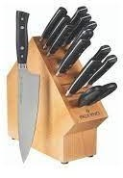
Renaissance Wood Products Ltd
Source: CPA Intermediate Management Accounting Primer
Renaissance Wood Products Ltd. manufactures wooden knife blocks. The marketing manager wants to set the selling price of these blocks. There are two distinct designs. The simpler design is the curve block, which holds four knives. The more complicated design is the square block, which holds eight knives. The production manager has just completed a production run of 350 of the curve blocks. The following data pertain to this run of curve blocks:
Direct Materials:
Item | Amount
Opening Inventory, DM | $500
Purchases of direct materials | $1,000
Ending inventory, direct materials | $625

Slide 50
Renaissance Wood Products Ltd. (cont’d)
Direct Labour:
Direct labour to make the blocks was 52.50 hours at $25/hour.
Budgeted indirect costs for the year (for all jobs):
Item | Amount
Supplies such as glue and stain | $840
Hydro | 1,230
Machine maintenance | 1,250
Machine depreciation | 3,000
Indirect labour | 16,630
Total budgeted indirect costs | $22,950
Machine hours is the cost driver for the indirect costs. The budgeted machine hours for the year are based on the production of 4,200 curve blocks at 0.30 hours each and 3,600 square blocks at 0.50 hours each. The machine hours used to produce the 350 curve blocks are the same as the budgeted level.
What if Actual OH ≠ Applied OH?

Slide 51
Renaissance Wood Products Ltd. (cont’d)
Source: CPA Intermediate Management Accounting Primer
Required:
Calculate the total cost for 350 curve blocks.
Calculate a unit cost per block.
Renaissance’s pricing policy is to mark up its products by 50% of product cost.
Knowing Costs are important…

Slide 52
Renaissance Wood Products Ltd. (cont’d)
Step | Description
1) | Identify cost object
2) | Identify and track direct costs
3) | Identify indirect costs
4) | Select cost allocation basis for indirect costs
5) | Compute rate of indirect cost allocation
6) | Allocate indirect costs to cost object
7) | Compute total costs for the cost object

Slide 53
Renaissance Wood Products Ltd. (cont’d)
Cost Object
  350 curve blocks
Direct Costs
Direct Materials
Opening Balance $500
Purchases $1,000
Less Ending (625)
$875
Direct Labour:
52.50 hours * $25/hour = $1,312.50

Slide 54
Renaissance Wood Products Ltd. (cont’d)
Indirect Costs
  $22,950
Cost Allocation Basis
  Machine Hours (4,200 curve blocks * 0.30 hours + 3,600 square blocks *
0.50 hours
3,060 hours
Compute rate of indirect cost allocation
  Rate for DMH: $22,950 / 3,060 = $7.5/hr

Slide 55
Renaissance Wood Products Ltd. (cont’d)
Allocate indirect costs to cost object
  $7.50/hr * 350 * .3 hours
    $787.50
7.
 | Compute Total | Cost
Direct Materials |  | $875
Direct Labour |  | $1,312.50
MOH |  | $787.50
Total |  | $2,975
Per Unit (350) |  | $8.50
Issue: Are Machine Hours the
driver of indirect costs?

Slide 56
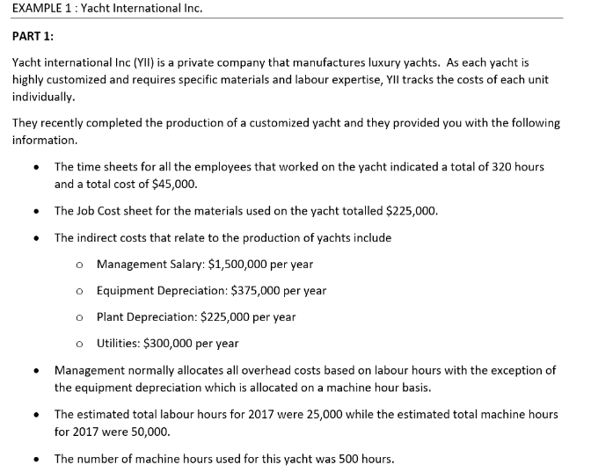
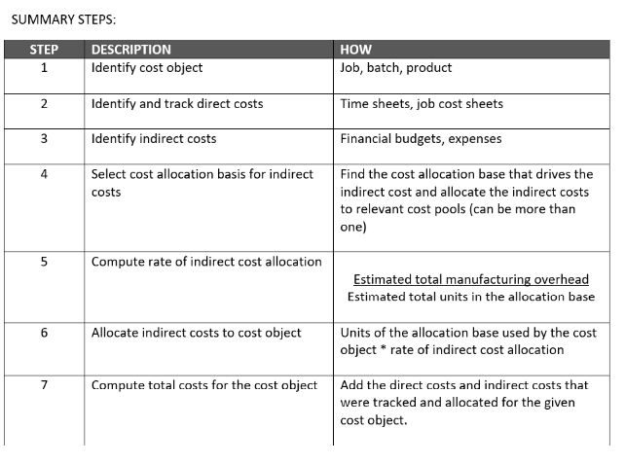
Let’s apply
Try to complete the student handout in Class 3 module.

Slide 57
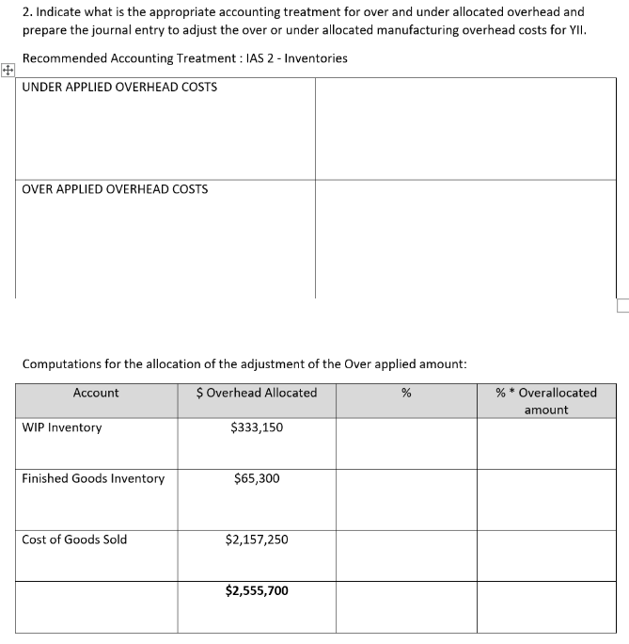
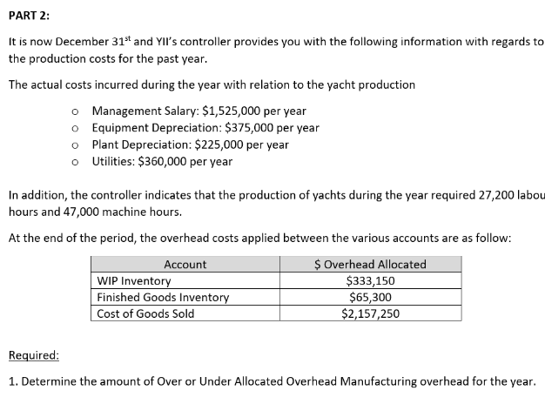
Let’s apply
Try to complete the student handout in Class 3 module.

Slide 58
Any Questions?

